Slide 1
Overview of Node Package Manager

Slide 2

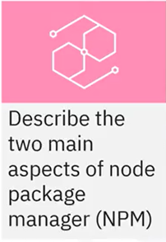

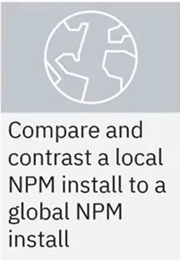
What you will Learn

Slide 3

Package managers
• Set of tools to deal with modules and packages containing dependencies
• Also called a package - management system

Slide 4
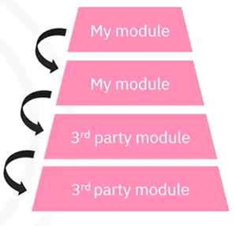
Dependencies
• Code in the form of a library or a package reused in a program
• Libraries and packages contain many dependencies
• A library does not depend on code outside of it to function

Slide 5
Package Manager responsibilities
Automate:
Finding
Installing
Upgrading
Configuring
Maintaining
Removing
Package mangers:
• Maintain a database of
dependencies and versioning
• Ensures software has correct
dependencies

Slide 6
Node package manager (NPM)
• Default package manager for Node.js
• Two functions
• Provides a command line interface (CLI) to publish and download
packages
• Behaves as an online repository of JavaScript packages
• The repository is a database of packages that tracks package
versions

Slide 7
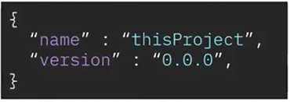
Package. Json file
• File located in a project's root directory
• NPM uses package.json to determine dependencies
• Contains key-value pairs that identify the project

Slide 8

Local install
• NPM packages can be installed locally or globally
• Use local install for use with packages within your application
• Run the local install command from the directory you want the
package installed in
• Local install is NPM's default behavior

Slide 9
Local install command
Use the NPM CLI to enter:
This command creates a directory named
node_modules with the package and its dependencies
in your current working directory.

Slide 10

Global install
• Packages can also be installed globally
• A globally installed package will be used by all applications on the machine
• Use judiciously
• If you have different versions of the project on your machine, they will all
use the globally installed packages
• Might break compatibility with other dependencies

Slide 11
Global install command
Use the NPM CLI to enter:
The command is the same as the local install
command but adds the "-g" option

Slide 12
Recap
In this video, you learned that:
• The package manager ensures a piece of software has the
dependencies it needs to run correctly
• NPM provides a command line interface tool and also functions as
an online database of JavaScript packages
• NPM uses the metadata in a package.json file to determine a
package's dependencies
• A local install means only the application within the directory of the
installed can access the package whereas a global install means
that any application on the machine can access the package

